Slide 1
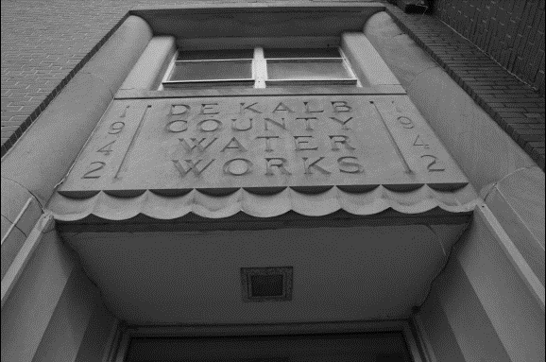


“The Path Forward”
DeKalb County Water & Sewer
Capital Improvement Program (CIP) Funding
November 12, 2024 Townhall Meeting
Picture: Scott Candler Plant - main building entrance

Slide 2
Executive Summary
DeKalb County has successfully initiated a plan to address the deteriorating water and sewer infrastructure
  Completed $1.25B in investments since 2017
  Used multiple funding sources for the water and sewer infrastructure investment (grants, low interest loans, SPLOST, federal and state support, fees, bonds)
  February 2021 - the BOC approved CIP 2021 which included improvements to Scott Candler Water Treatment Plant and other water and sewer infrastructure as well as considering the first ever master plans for water and sewer
In 2022, the Governing Authority adopted a 6% rate increase. This is the only rate increase in the past decade (since 2014).
Due to optimization efforts, which decreased costs and increased revenues, additional rate increases were delayed.
Post COVID-19, inflationary pressures dramatically increased operational and capital costs.
  Funding is available for ongoing capital improvement projects at Scott Candler Water Treatment Plant but only through 2025. Similarly, funding is limited for other water and sewer projects.
  Therefore, additional funding is needed to complete critical infrastructure repairs and improvements.

Slide 3
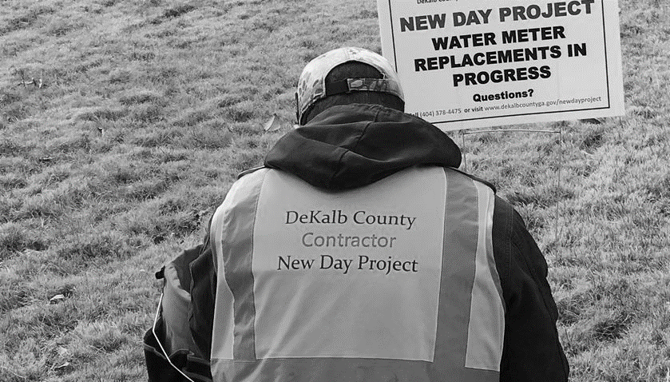
DEKALB’S WATER AND SEWER INFRASTRUCTURE SUCCESSES
$1.25B CIP Investment Since 2017
  $520M Water Infrastructure
  $730M Wastewater Infrastructure
Contractor working on New Day Project

Slide 4
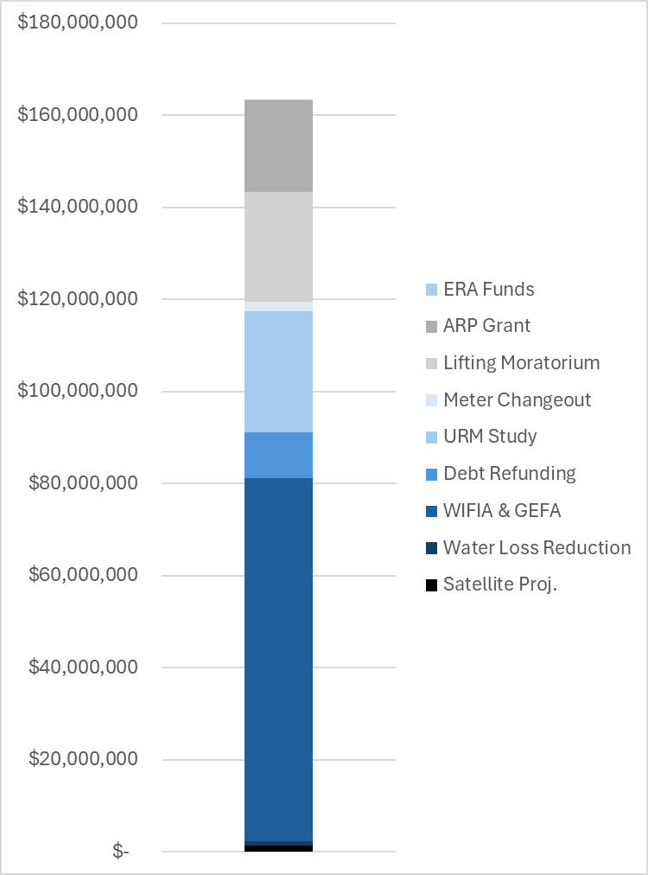
Savings 2021-2024
Decreased Expenses ($90,000,000 to $110,000,000):
  Reducing Water Loss ($1,000,000 saved)
  Maximizing Low Interest Debt WIFIA & GEFA ($79,000,000 in costs avoided)
  Debt Refunding ($9,800,000 saved)
  Eliminating Negative Arbitrage ($20,000,000 avoided)
Increased Revenue ($74,000,000):
  Commercial Accounts Audit ($26,413,763 collected)
  Meter Changeout Program ($2,000,000 collected)
  Lifting the Service Disconnection Moratorium ($23,800,000 collected)
  American Rescue Plan Grant ($20,000,000)
  Emergency Utility Assistance ($1,655,512 awarded)
By increasing revenues and reducing cost, DeKalb has optimized over $164 million in revenue savings from 2021 through 2024. Hence delaying the need for a rate increase.

Slide 5
Impact of Inflation Post Pandemic
Inflationary Pressure – Atlanta Engineering News Report (ENR) Construction Cost Index (CCI) – pre-pandemic to current peaked with an 40% increase but ductile iron prices have increase 80%
In January 2024 capital improvements at Scott Candler Water Treatment Plant were estimated at $250M but are now $294M
  Added one project
  Refined cost based on recent construction estimates
Considering the impact of the recent storms on supplies and contracting capabilities.
Notes:
X-axis change
Cumulative - fixed
Note:
What is the percentage change in total from Year 1-20 – 20.3%
What is the cumulative rate increase in total? -68.25%

Slide 6
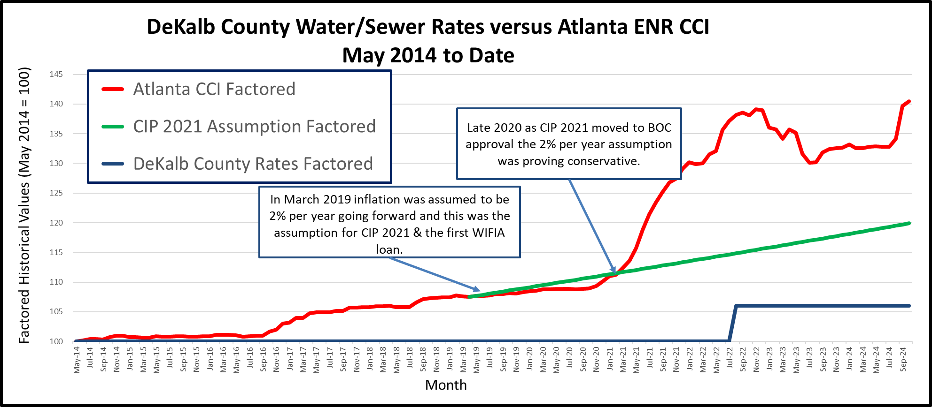
Cost Escalation
Atlanta Engineering News Record (ENR)
Construction Cost Index (CCI)

Slide 7
Water & Wastewater System Components & Gaps

Slide 8
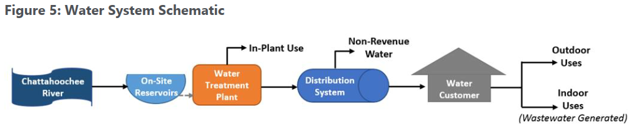
DeKalb County’s Single Water Source/Supply
The Chattahoochee River is the County’s sole water source.
DeKalb County is the only county in the metro Atlanta area of its size (population served) with one water supply source and one Water Treatment Plant (WTP).
Renew 1942 era components, pumps and plant controls.

Slide 9
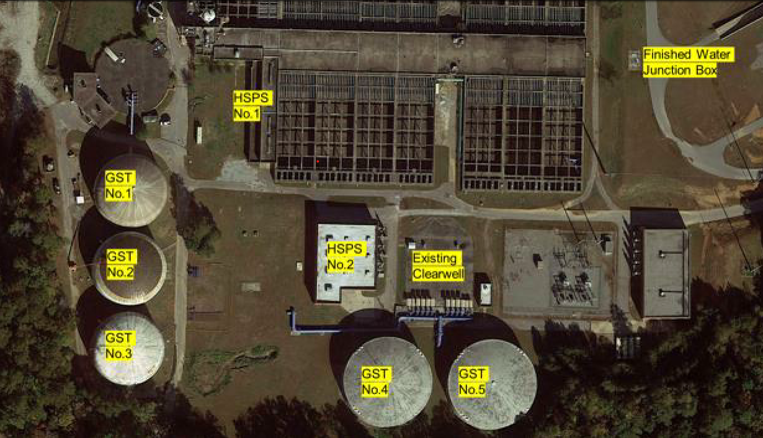
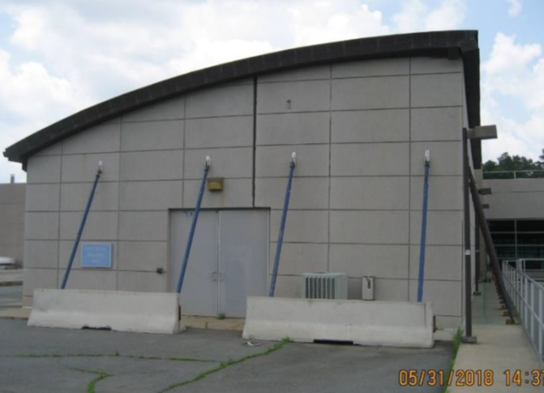
Remnant aging facilities
Electrical Building – structural issues – project in procurement
  Originally built in 1942.
  New plant was constructed in 2007.
  Remnants of the old plant remain

Slide 10
Water Distribution System
  21 tanks improvements - 16 in system and 5 at plant
  ~3,000 miles of water pipe ranging from 1.5- to 54-inch diameter (annual replacement for asbestos cement pipe)
  Address prestressed concrete issues. E.g. McLendon Road 42” diameter failure in Feb/April 2024
  Create first transmission main addition in 50 years

Slide 11
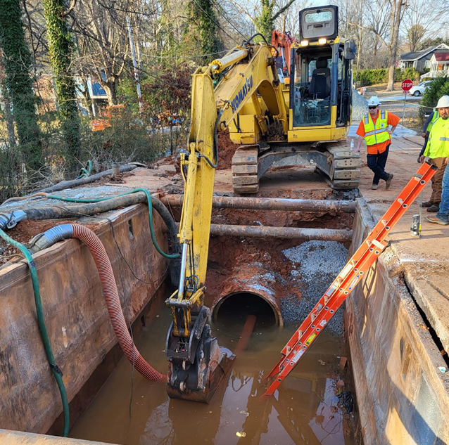
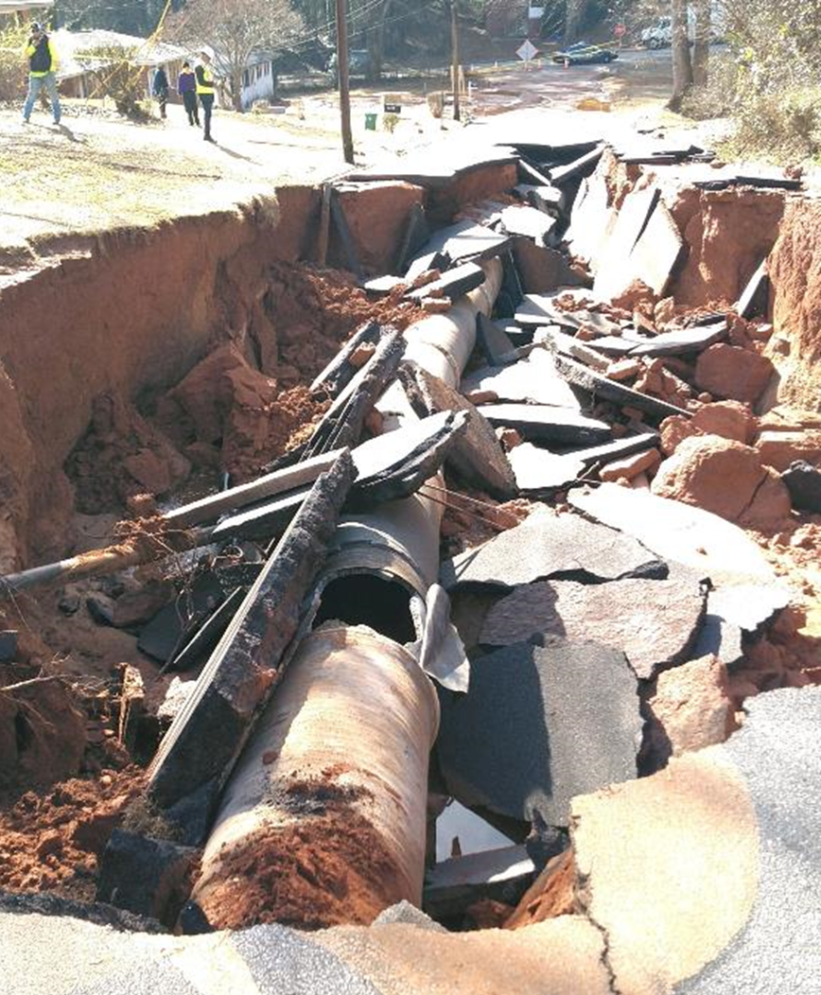
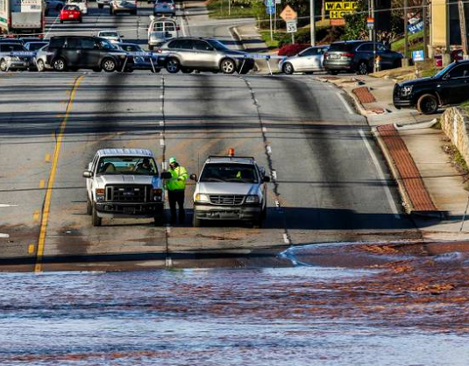
Aging Transmission Mains
Both the Buford Highway pipeline that failed in 2019 and the McLendon that failed in 2024 carry about 35% of the flow in the system.
Buford Highway – 2019
Ductile Iron
McLendon Road
42”diameter
Feb/April 2024
Prestressed Concrete
Celia Way
January 2023
Prestressed Concrete

Slide 12
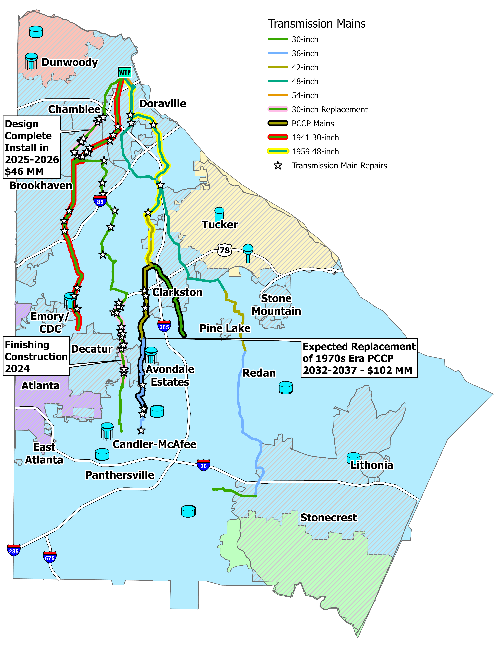
Nearly 85% of the County’s water passes through these 4 pipes
Nearly 60% of the County’s water passes through these 5 pipes and 98% of the water supplying customers south of Hwy 78
DeKalb has not built a transmission main in 50 years.

Slide 13
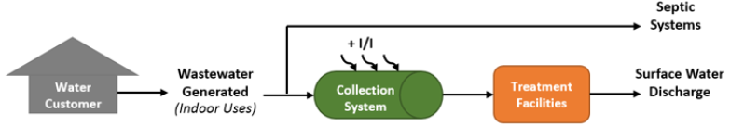
Wastewater System Overview
  Collection System:
  Has been the focus of Consent Decree efforts since 2011
  Over 1,000,000 LF of system rehabilitated or replaced since 2017 (7.3% of system) – over $725M spent on wastewater since 2017
  Still … continued major investments are still required by Consent Decree and growth.

Slide 14
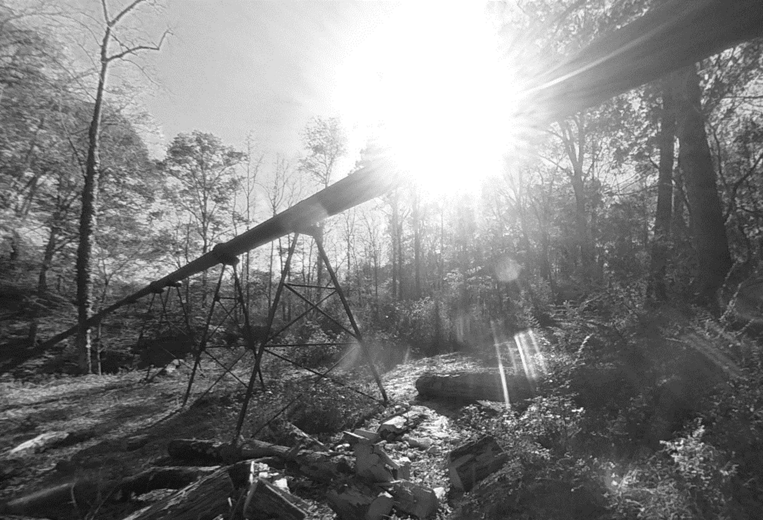
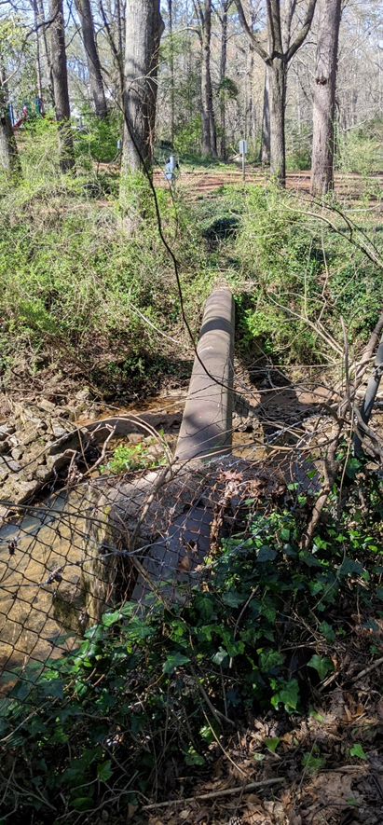
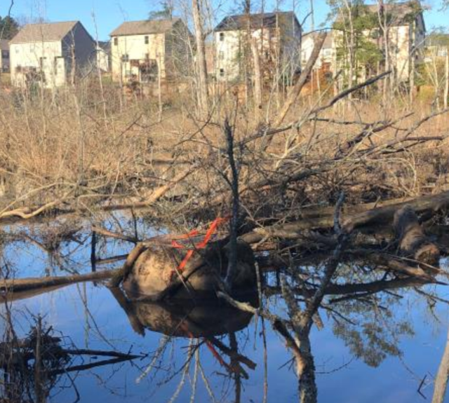
Major Trunks
Remaining projects required by the modified Consent Decree are to increase the capacity of the major trunk sewers and addressing the Priority Fix List.
This is a major undertaking with projects larger, more complex and more expensive than previously thought in CIP 2021:
Pipe diameters up to 72”
28 miles of trunk sewer
Over 700 properties with direct impacts
Three interstate freeway crossings (I20, I285 & I85).

Slide 15
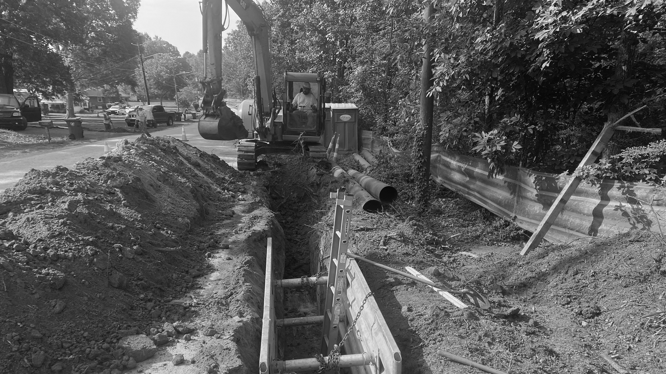
Stone Mountain/Lithonia Water Project
Completed 2023 – WIFIA 2 Loan
MOVING FORWARD
Future Optimization Efforts & Funding Sources

Slide 16
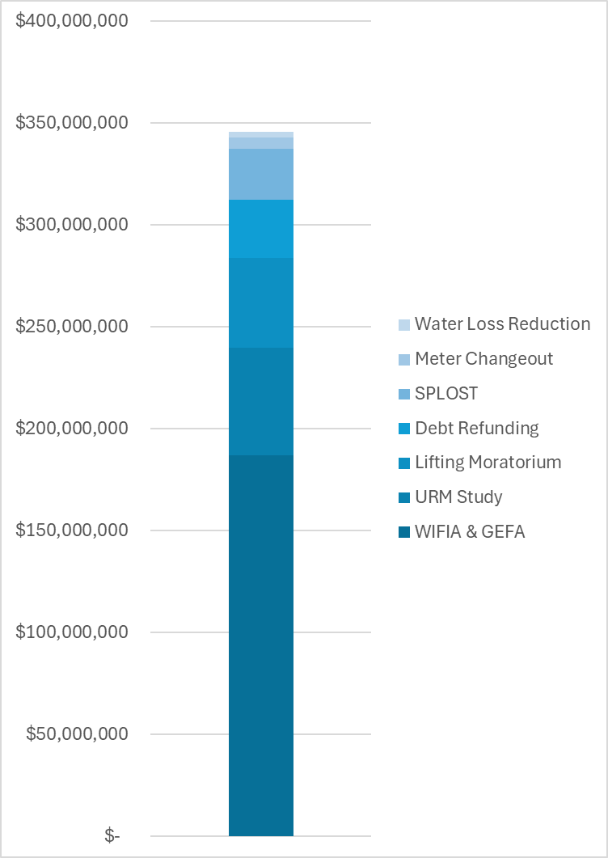
Future Optimization Efforts
Continue Reduction in Expenses:
  Reducing Water Loss ($2,750,000)
  Maximizing Low Interest Debt WIFIA & GEFA ($187,000,000)
  Savings from Debt Refunding ($28,500,000)
Continue to Increase Revenues:
  Improved Collections ($44,000,000)
  Applied for $52,000,000 in multiple grant-type funding (assisted by FEMA, GA DNR, USACE and Congressman Johnson)
  Special Purpose Location Option Sales Tax; SPLOST ($25,000,000)
    Commercial Accounts Added Revenue ($52,800,000)
    Meter Changeout Program ($5,500,000)
Because of improvement efforts, Watershed will save a total of $346 million - reducing the need for additional revenues in the face of inflationary pressures

Slide 17
To Fill the Funding Gap Driven by Inflationary Pressures and the Need to Fix the Infrastructure
Increase water and wastewater rates implemented around March 31, 2025, and annually through 2027 (4-month development, programming and testing period)
Adopt three-year schedule of water and sewer rates (2025 through 2027)
Issue bonds - $100M in 2025 due to parity constraints
Continue looking for additional funding sources

Slide 18

  FORECASTED REVENUE NEEDS
Addressing the impact of deteriorating infrastructure

Slide 19
Forecast With
No Rate Increases
Rate increases are needed to meet Working Capital Reserve and Debt Service Coverage targets (and minimum requirements)
Notes:
Column rates, cumulative increase as a line, CPI U and CPI W&S

Slide 20
Forecast With
No Capital Program
Just to Support DWM Operations
Note: rate increase implementation January 1 of each year
Notes:
Replace working capital

Slide 21
Rate Increase Recommendation
  Address issues at the Scott Candler Water Treatment Plant, the water system and the wastewater system
  Meet Bond Resolution Requirements: rate increases are needed to meet minimum Rate Covenant requirements required by Bond Resolution.
  Maintain Financial Stability: financially stable utilities establish and meet financial metrics. While Watershed has established financial metrics, the metrics are not being met.
  Maintain Bond Ratings: the lack of rate increases in 2023 and 2024 could result in negative rating actions.
  Fund the Capital Program: funding the capital program will require additional debt which requires rate increases to support. The Bond Resolution stipulates requirements for additional Parity bonds, rate increases are needed to meet these requirements.

Slide 22
  Customer Bill Impacts and Affordability

Slide 23
DEKALB WATER BILLING – BY THE NUMBERS
Financial assistance for customer bills: $2.9M
Extended Installment Plans: 10,434 (2021 to 2023)
Disconnections in 2023: 4,687 (2.3% of total customers)
No disconnections 2016-2022
Customer disputes: 69/month (0.03% of customers)
Customers electing mediation: 20 (since 2016)

Slide 25
Residential Water & Sewer Bill - 6,000 gallons of Usage per Month – 2027 Rates
Notes:
Entities under a consent decree
Atlanta also has access to a MOST
Miami-Dade does not include specific CD Funding
DC Water includes CRIAC rate for CD Funding
Other funding sources for Baltimore and Nashville are currently unknown
Future rates are based on information available as of September 2024. Where information was not available, future rate adjustments are estimated.
Notes:
Average of consent decree systems: $137.64

Slide 26
Affordability Measure – Bill as a percentage of Median Household Income – 2027 Rates
Notes:
Entities under a consent decree
Atlanta also has access to a MOST
Miami-Dade does not include specific CD Funding
DC Water includes CRIAC rate for CD Funding
Other funding sources for Baltimore and Nashville are currently unknown
Future rates are based on information available as of September 2024. Where information was not available, future rate adjustments are estimated.
Average: 1.91%
Note - 2027 MHI escalated based on last 5 year’s of MHI growth (5%) as reported by Federal Reserve Economic Data with their consideration of U.S. Census Bureau data

Slide 27
EPA Water and Wastewater Utility Customer Assistance Program (CAP) Study
EPA reviewed 795 utilities across the United States
The study shows that approximately 30 percent of surveyed utilities offer one or more CAPs
The most common CAP is a bill discount
DeKalb offers four CAPs
Note: Of the 795 utilities reviewed, 228 utilities offer a total of 365 CAPs. Several programs fit under more than one program type.
Source: EPA report, “Drinking Water and Wastewater Utility Customer Assistance Programs” – April 2016

Slide 28
DeKalb C.A.R.E.S.
Customer Assistance Programs
Customer Discount Program (discounts for income eligible residential customers)
Governing Authority To Allocate Funding Annually (adjust at mid-year)*
One-time Customer Assistance Fund for those facing disconnection*
Round-up bill program or
$1 or $2 donation option on bills
Extended Payment Plans
ARP – Repair Of Private Infrastructure
Identify and fix the source of water leaks and associated high usage
Convert from septic tanks to sewer service
Repair of sewer laterals
ERA – Utility Assistance
Provide one-time assistance to rental customers impacted by COVID
Toilet Rebate Program
One Time deferral of bill payment without fees
Private Leak Credit Adjustment
Up to 7 years for large balances accrued during the pandemic
Up to 2 years otherwise
Encourage reduced water usage
$50-$100 per toilet

Slide 29
DeKalb C.A.R.E.S. – Proposed Customer Discount Program
Proposed Eligibility:
Household income must be at or below ~50% of the Area Median Income for the Atlanta-Sandy Springs-Roswell, GA HUD Metro FMR Area.
Customers must not be participating in any other Federal or State water and/or sewer assistance programs to be eligible.
The beneficiary must be a verified DWM customer before approval.
Only residential customers are eligible for this program; commercial and non-profit customers are excluded.
Customers with past due accounts must be enrolled in a payment program to qualify for a bill credit.

Slide 30
DeKalb C.A.R.E.S. – Proposed Customer Discount Program
Other Proposed Program Guidelines:
Eligible customers are enrolled in the program for a 12-month period and must re-apply thereafter.
The program will be administered by a designated third-party organization.
The BOC will determine the annual program funding, and bill discounts will be provided as funds are available.
The applicant must be both the customer and tenant of the property to which the credit is applied.
The property for which the credit is applied must be served by an operable water meter.
Under no circumstances will a bill discount result in a disbursement or payment to a customer.

Slide 31
Example: Percentage-Based Bill Discount on Usage Charges
The United Nations identifies essential water need as 50 to 100 liters per person per day; 400 to 800 gallons per person per month.
Discount amount can be up to the calculated amount but is not to exceed the total bill.
Notes:
Examples: Using a 75% Credit Amount, a 2- occupant household using 2,000 gallons per month would receive a bill of $17.47 ($38.94 less $21.47) Using a 75% Credit Amount, a 2-occupant household using 4,000 gallons per month would receive a bill of $48.03 ($69.50 less $21.47)

Slide 32


Presentations Available At:
https://www.dekalbcountyga.gov/watershed-management/2024-capital-improvement-program-cip

Slide 33
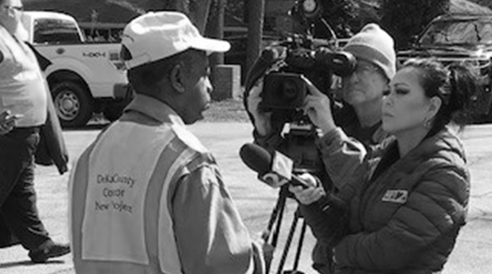
QUESTIONS?

